Slide 1

PH240C Final Project
The Influence of Gene Expression
on Survival time of Patients with
Breast Cancer
Shuyao Wang, Yanbo Wang, Sergio Mares

Slide 2
Motivation
Breast Cancer
One of the most common cancers for women
Second biggest reason of women’s death
1.5 Million diagnosis cases each year 5700000 death in 2015
Metastatic cancer
The Importance of Early Diagnosis

Slide 3
Sergiusz et al., 2021
Diagnosis methods of breast cancer, nuclear medicine, breast biopsy, biomarkers, ultrasound imaging etc., have been used to predict the survival rate of breast cancer patients applied with different molecular subtypes including Luminal A, Luminal B, HER2-enriched, and basal-like in the experiement.
Patients within the same molecular subtypes group also indicated different results, which made the researchers difficult to make a strong accurate conclusion
Clinical behaviors of patients with different gene expression levels might be different, and thus needs individualized therapy plans for different patients of specialized cases.

Slide 4
Ning et al. (2020)
The expression level of 784 different genes, there are 10 important genes found to show extremely strong significance related to the survival time of patients who got breast cancer from the GSE42568 gene expression dataset.
Summarizing these results, gene expression is very likely to be related to the longevity of breast cancer patients.

Slide 5
Goal
We are interested in further examining the topic of significant genes related to the survival time of different breast cancer patients using a different dataset and exploring the potential pair genes that contributed to the survival time as well.
There are two questions we are interested in:
We want to know if we could make predictions on the survival time of patients with breast cancer based on their gene expression information.
We want to find important single or pairs of genes that are predictive of the survival time of patients.

Slide 6
Dataset
cBioPortal for Cancer Genomics
a resource for the interactive exploration of multidimensional cancer genomics
data sets hosted by the Center for Molecular Oncology at Memorial Sloan
Kettering Cancer Center (MSK).
- Targeted sequencing of 2509 primary breast tumors with 548 matched normals
Aged ranging from 21 and 96 years
With chemotherapy and hormone and the ones without
Different physiological information
Tumor size, vital status, ER status, HER2 status, menopausal status, PR status
Focus on patients’ survived time, survived status, and the types of genes included.

Slide 7
Methodology
Random forest
We first implement a random forest model for overall survival status and time.
Then we calculated the feature importance under two different measures: Gini impurity and permutation importance, and selected genes that are important under both measures.
Iterative random forest (iRF)
We then applied iRF(S. Basu et al., 2018)on survival time in order to find co-active gene pairs (van Dam et al. 2017) that are important. iRF assigns a weight to each feature, and in each iteration, the weight is calculated by its feature importance. The weight of a feature is the probability that a feature is selected in each split. After several iterations, we take random intersections of decision paths in the forest, and the more frequently a pair of genes appears, the more important it is.

Slide 8

Data Analysis
Pre-process
Classify survival time (which is a continuous variable) into long and short, in order to run a classification tree.
Drop the data points with NA’s;
Do dimensionality reduction of gene expression data based on the variances:
We chose the genes that have bigger variance of expression levels across individuals, since they tend to behave more differently among the patients.
We didn’t choose PCA here because PCA would give us the linear combination of gene expressions, while we are interested in investigating individual genes rather than their linear combinations.

Slide 9
Data Analysis
Data splitting
Data is split into 80% of training data and 20% of test data.
Turning parameters
On the training data, k-fold cross validation is used in order to find optimal parameters for the model.
For each possible parameter choice, we run a 8-fold cross validation, and compared their accuracy. We mainly tuned mtry (the number of variables to possibly split at each node), and split rules (for example Gini impurity and Hellinger). Finally we found that mtry = 90 and Gini impurity perform the best.
- Test model accuracy
Finally, we apply the optimal model into the 20% hold-out set to see it’s accuracy on unseen data.

Slide 10
Result
For random forest model on survival status:
The accuracy on the testing set is 50%
Four important genes are found: FKBP5, STC1, ZFR, and CTBR1.
For random forest model on survival time:
1. The accuracy on the testing set is 67%
Four important genes are found: AURKA, PTTG1, CDCA5 and
TPX2 is based on two feature importance measures.

Slide 11
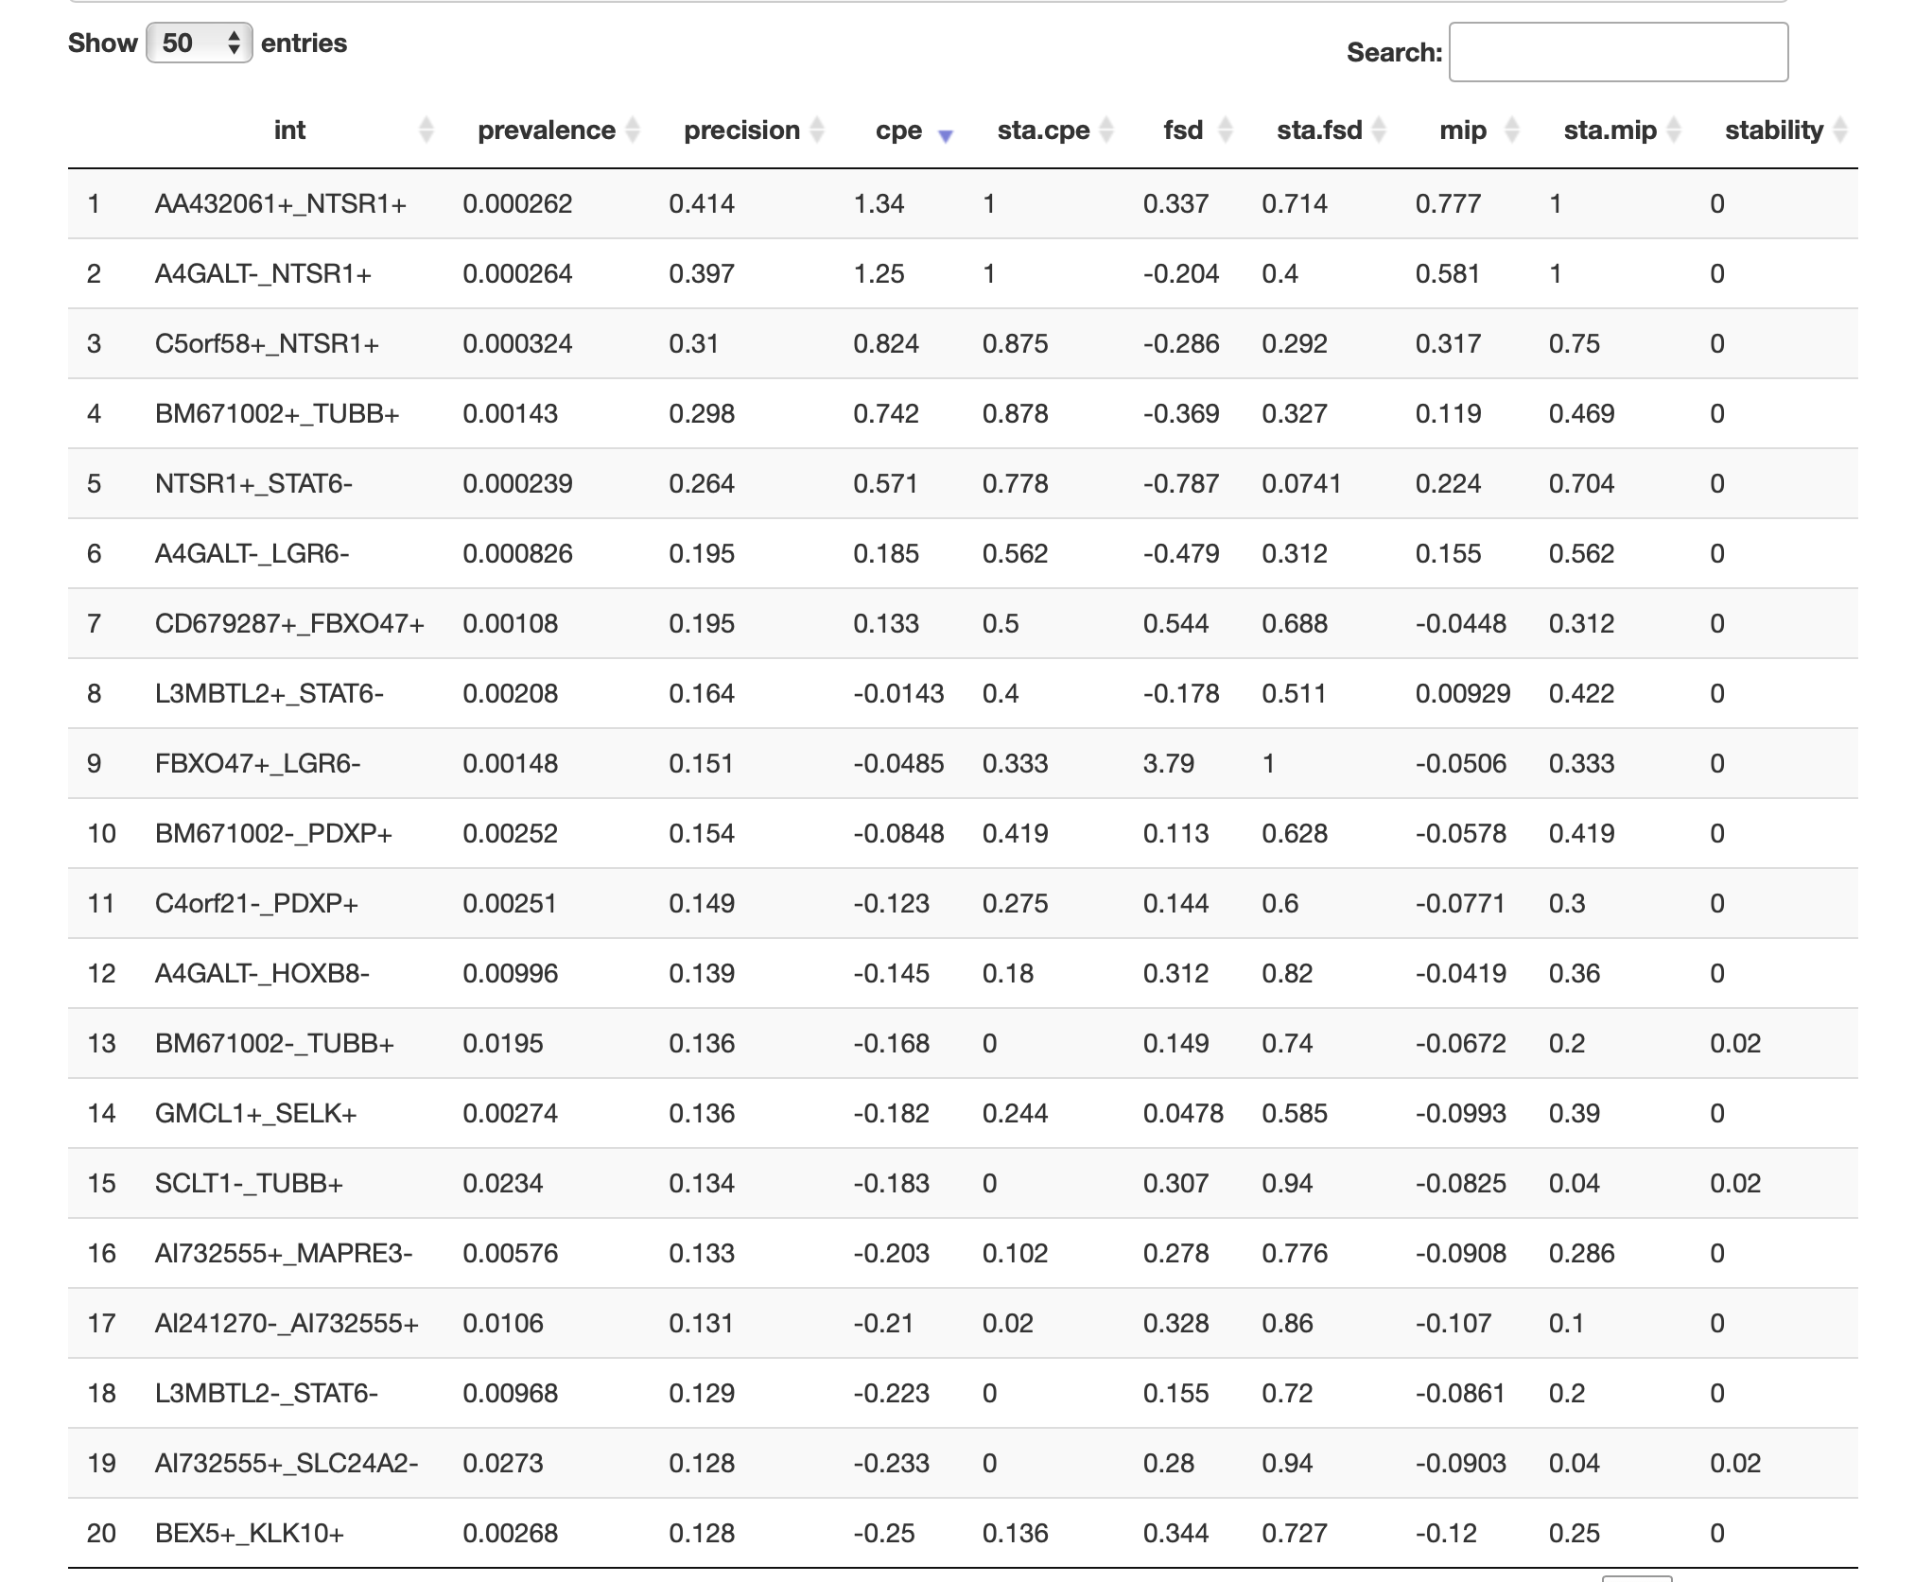
Result
Iterative random forest model on survival times:
1. The accuracy on the testing set is 84%
2. Four pairs of important co-functioning genes are found: “BEX5+_MMP25+“,”DYRK2+_MMP25+“,”MMP25+_TMEM144+” and “BGN-_HOXB8-”

Slide 12
Summary
Since from the AUC curve, the result is not very significant in predicting the survival status, we cannot easily make a conclusion about the gene expression contributing to that.
However, our result of gene expression on breast cancer patients’ survival time did a better job than the survival status, especially the co-active gene pairs.
Thus, we strongly recommend researchers further explore the impact of the following four pairs of important co-functioning genes on breast cancer later to help improve the ways of diagnosis methods.
“BEX5+_MMP25+“,”DYRK2+_MMP25+“,”MMP25+_TMEM144+” and “BGN-_HOXB8-”

Slide 13
Reference
Kulaga AY, Ursu E, Toren D, Tyshchenko V, Guinea R, Pushkova M, Fraifeld VE, Tacutu R. Machine Learning Analysis of Longevity-Associated Gene Expression Landscapes in Mammals. Int J Mol Sci. 2021 Jan 22;22(3):1073. doi: 10.3390/ijms22031073. PMID: 33499037; PMCID: PMC7865694.
Łukasiewicz S, Czeczelewski M, Forma A, Baj J, Sitarz R, Stanisławek A. Breast Cancer-Epidemiology, Risk Factors, Classification, Prognostic Markers, and Current Treatment Strategies-An Updated Review. Cancers (Basel). 2021 Aug 25;13(17):4287. doi: 10.3390/cancers13174287. PMID: 34503097; PMCID: PMC8428369.
Mai F. Minamikawa, Keisuke Nonaka, Hiroko Hamada, Tokurou Shimizu, Hiroyoshi Iwata, Dissecting Breeders’ Sense via Explainable Machine Learning Approach: Application to Fruit Peelability and Hardness in Citrus, Frontiers in Plant Science, 13, (2022). https://doi.org/10.3389/fpls.2022.832749
Sipko van Dam, Urmo Võsa, Adriaan van der Graaf, Lude Franke, João Pedro de Magalhães, Gene co-expression analysis for functional classification and gene–disease predictions, Briefings in Bioinformatics, Volume 19, Issue 4, July 2018, Pages 575–592, https://doi.org/10.1093/bib/bbw139
Merle Behr, Yu Wang, Xiao Li, Bin Yu, Provable Boolean interaction recovery from tree ensemble obtained via random forests, Proceedings of the National Academy of Sciences, 119, 22, (2022)./doi/10.1073/pnas.2118636119
Carrie L. Branch, Georgy A. Semenov, Dominique N. Wagner, Benjamin R. Sonnenberg, Angela M. Pitera, Eli S. Bridge, Scott A. Taylor, Vladimir V. Pravosudov, The genetic basis of spatial cognitive variation in a food-caching bird, Current Biology, 32, 1, (210-219.e4), (2022). https://doi.org/10.1016/j.cub.2021.10.036

